Slide 1
The impact of ESG ratings on Financial Performance
Do companies with higher ESG ratings experience better financial outcomes?

Slide 2
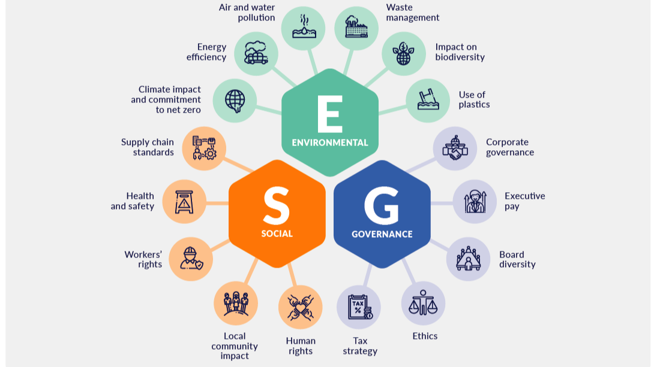

Slide 3

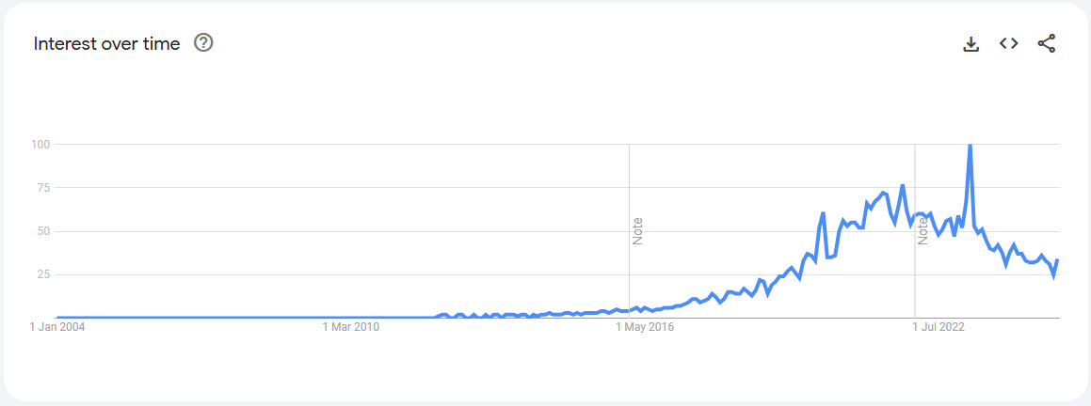
Can ESG investing be practical?
Key Stats:
ESG investing 📈 +456% (2005 - 2020) [1]
88% of Publicly Traded Companies have ESG Initiatives in Place [2]
43% of Investors - Fans of ESG investing (2024) [3]
17% - Optimistic about increased performance
✔️ Worthy economic endeavour
❓ Economically viable investing

Slide 4
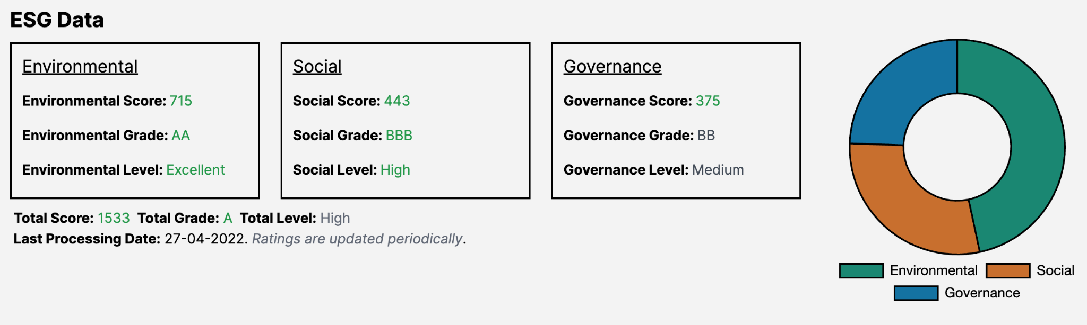
Datasets
Public Company ESG Ratings Dataset
(ESG ratings for over 700 mid / large-cap companies across various industries)
Environment, Social and Governance Data | Data Catalog
(Additional ESG data on regional level)
S&P 500 ESG and Stocks Data 2023-24
(The ESG and Stocks data of S&P 500 Constituent Companies)
Stocks API - Polygon
(Latest Market data from all US stock exchanges)
Yahoo Finance API yfinance
(Latest stock market data, 4 years historical data, and ESG scores)
ESG Data
Both
Finance Data

Slide 5
Proposed Project Workflow
Data Acquisition & Cleaning
Use SQL/ BigQuery to clean and join datasets
Python to web scrape financial data and handle APIs
Data Analysis
ESG Scores <-> Financial Performance Metrics
Machine Learning
Data Visualisation
Streamlit
Data Insights
⬆️ ESG scores => ⬆️ Returns & ⬇️Volatility?
Key findings + Actionable insights for investors & corporate decision-makers 📈✅

